Slide 1
Project Presentation of CO-OP Project at Industry (Module-2) (22CS421)
On
Comparative Evaluation of Machine Learning Models for Early Mental Health Risk Prediction using Workplace Survey Data
Pragati Kuchhal (2210994823)
Chirag Mahajan (2210991464)
Daksh Gupta (2210991472)
Sania (2210992246)
Supervised By
Mr. Shyam Goyal
Department of Computer Science and Engineering,
Chitkara University, Punjab

Slide 2
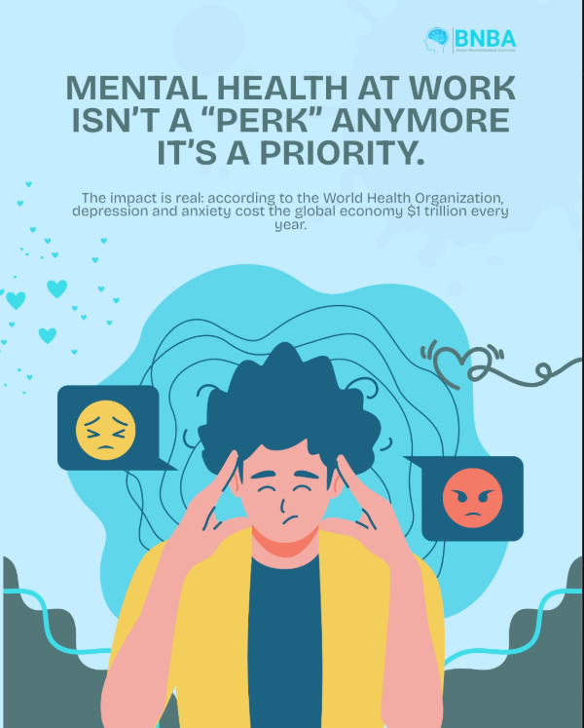
Introduction: The Digital Shift in Mental Health
Contextual Background
Mental health disorders are a leading cause of disability worldwide, yet there remains a significant “treatment gap” due to social stigma and lack of resources.
The Role of Technology
Traditional screening is infrequent and reactive. Machine Learning offers a proactive transition, identifying hidden patterns in behavioural data before a crisis occurs.
Research Goal
To evaluate and compare the efficacy of various ML algorithms in predicting mental health risks using workplace survey datasets.
2

Slide 3

Problem Statement: The Detection Gap
Current Challenge
Most mental health support is reactive. Help is only triggered after performance drops or a crisis occurs. There is no automated framework for effectively analysing non-clinical workplace data.
Data Complexity
Mental health is influenced by a complex web of factors(Work interference, family history, company benefits, and age). Manually identifying which individuals are at the highest risk is nearly impossible in large organisations.
The Specific Challenge
There is a lack of a standardised, automated, and accurate framework to analyse employee survey data to predict who requires mental health intervention.

Slide 4
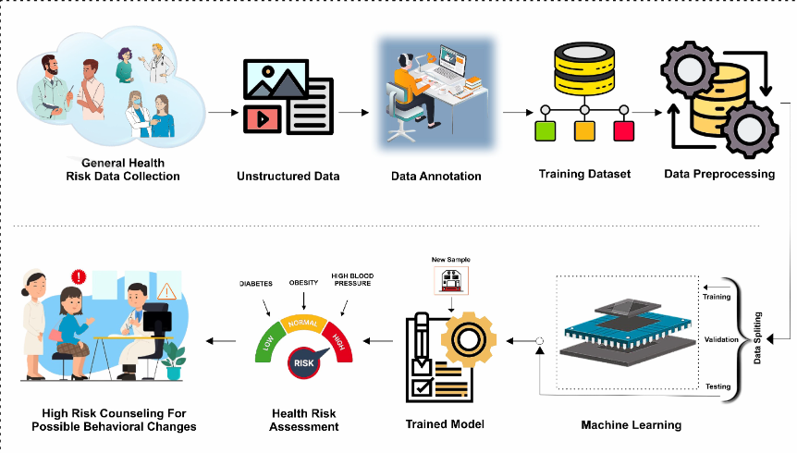
System Design: The Machine Learning Pipeline
Data Ingestion:
Input: Mental health survey dataset (1,259+ records).
Feature Set: Behavioural, demographic, and workplace attributes.
Preprocessing Engine:
Cleaning: Removing outliers (Age) and handling null values.
Encoding: Label Encoding for
categorical survey responses.
Scaling: Feature normalisation via
Standard Scaler.
Output Layer:
Binary Classification: Risk
(Treatment Required) vs. No Risk.
Evaluation via Accuracy and
F1-Score.
Model Implementation:
Comparative analysis: LR, SVM, Random Forest, and Gradient Boosting.
80/20 Train-Test split with Cross-Validation.

Slide 5
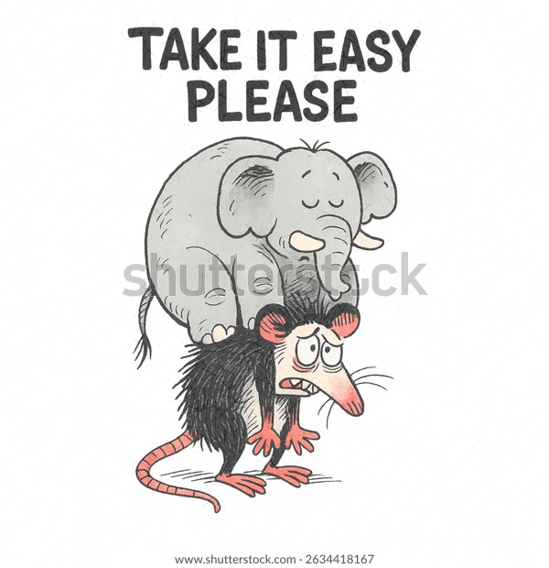
Data Insights & Performance Metrics
Feature Distribution:
Work Interference: Identified as the primary indicator for treatment needs.
Family History: Strong correlation observed between genetic factors and mental health risk.
Care Options: Significant disparity in employee awareness regarding company-provided mental health benefits.
Comparative Model Strategy:
Executing a performance face-off between Logistic Regression, SVM, Random Forest, and Gradient Boosting.
Success Criteria (The Metrics):
Accuracy: Overall percentage of correct predictions.
F1-Score: The harmonic mean of Precision and Recall (crucial for unbalanced survey data).
Precision: Measuring the model's ability to minimise false positives and false negatives.

Slide 6
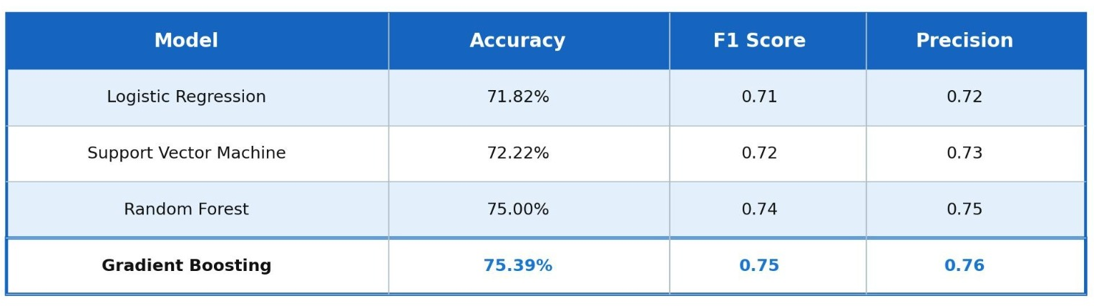
Performance Comparison of ML Models
The Winner: Gradient Boosting achieved the highest accuracy and F1-score, proving that boosting weak learners is highly effective for non-linear survey data.
Ensemble Superiority: Both Gradient Boosting and Random Forest significantly outperformed traditional models like LR and SVM.
Robustness: The high F1-Score of the GB model indicates a strong balance between identifying those who need treatment and avoiding false positives.
Insight: The 3.5% lead of GB over LR highlights that mental health risk factors do not have a simple linear relationship; they require the complex branching logic of tree-based models.

Slide 7

Conclusion: Towards Proactive Mental Health Management
Machine Learning Efficacy: Proves non-clinical survey data is a viable, high-accuracy predictor for mental health risks.
Ensemble Superiority: Gradient Boosting outperformed traditional models by successfully capturing complex, non-linear behavioural patterns.
Primary Drivers: Workplace factors like Work Interference and Care Awareness are stronger predictors than age or gender.
Operational Shift: Enables a transition from Reactive crisis management to Proactive early intervention strategies.

Slide 8



Future Scope & Research Horizons
Real-time Biometrics
Transitioning from static survey snapshots to continuous monitoring via IoT and wearable sensors for dynamic, real-time stress detection.
Explainable AI (XAI)
Implementing SHAP and LIME frameworks to provide human-interpretable reasons behind predictions, ensuring trust and clinical transparency.
Global Dataset Expansion
Scaling the architecture across diverse industries (Healthcare, Manufacturing) and cultural demographics to validate model robustness and bias-free screening.

Slide 9
Thank You
9

